Slide 1
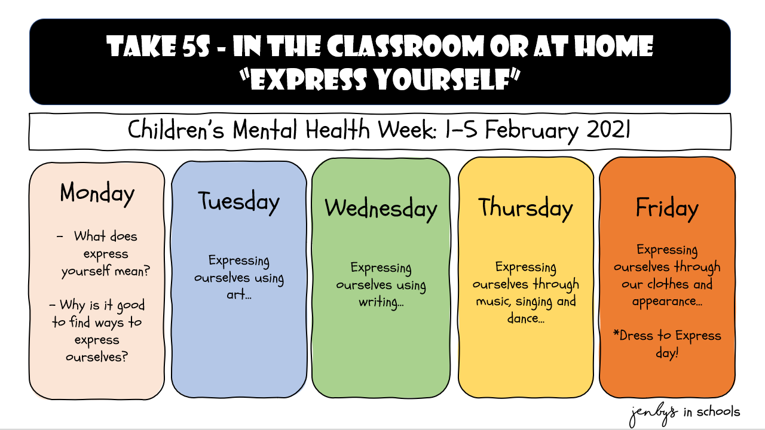

Slide 2
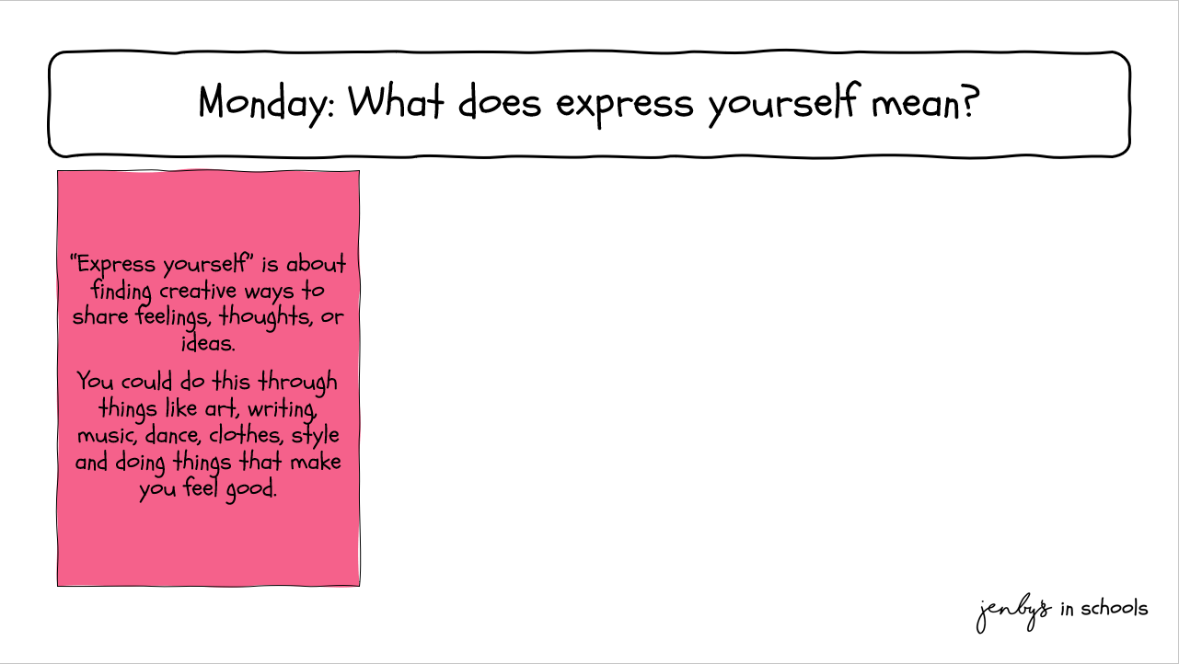


Slide 3
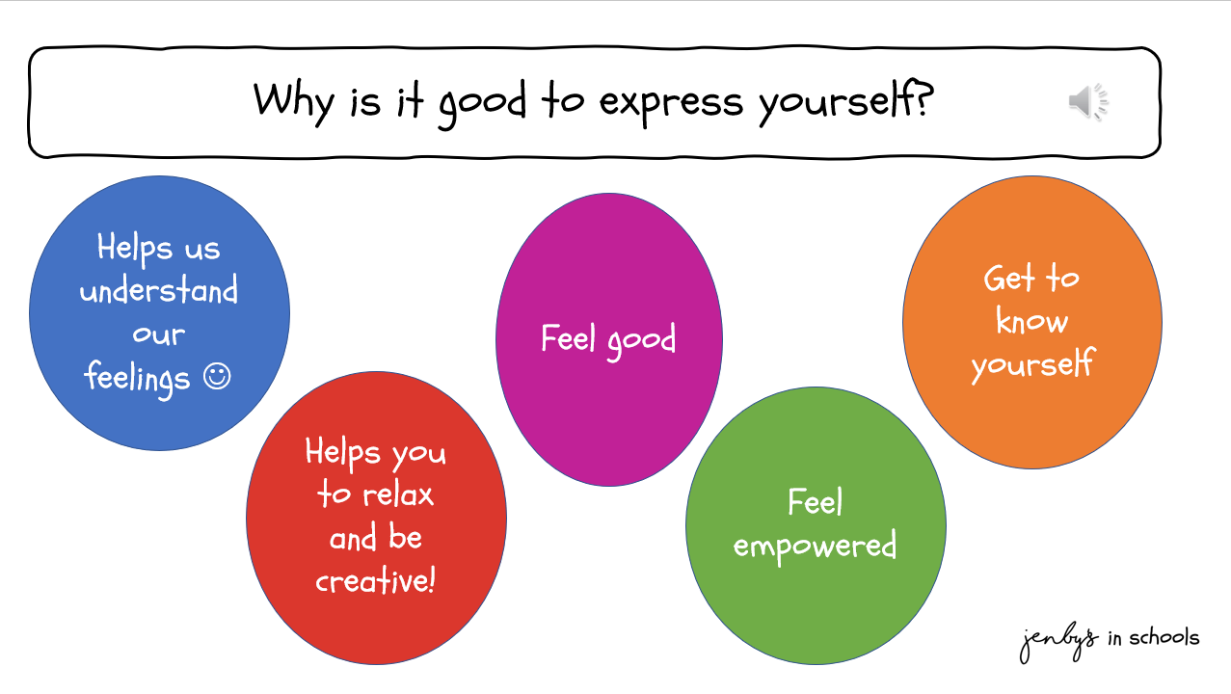

Slide 4
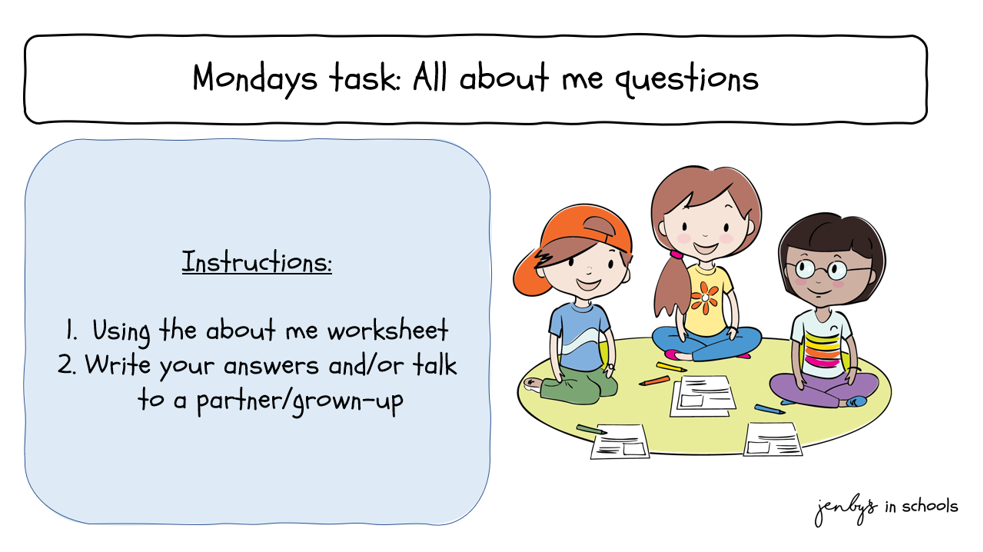

Slide 5
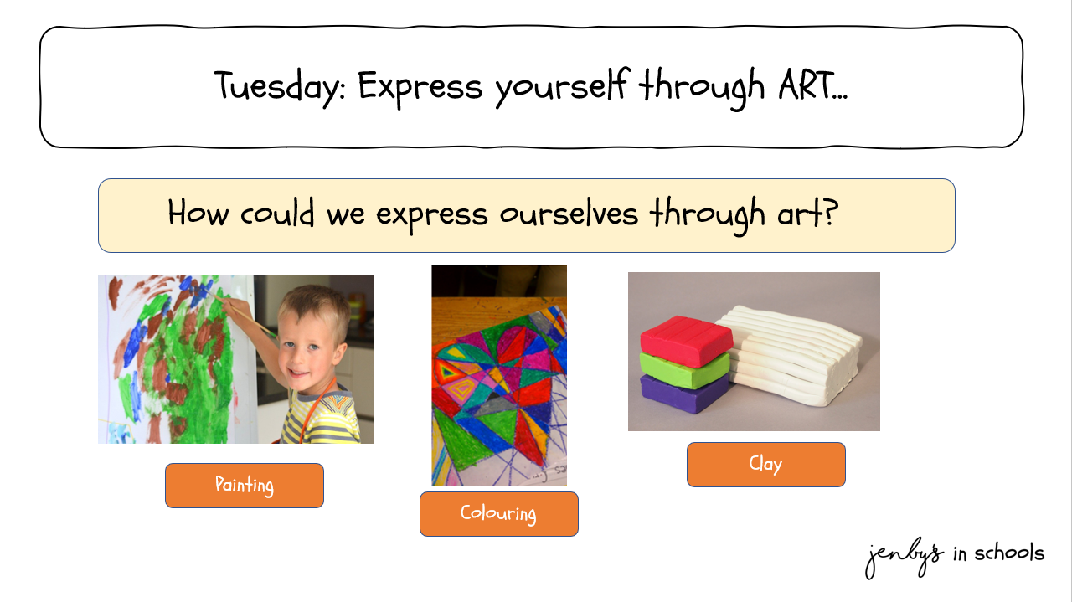
Tuesday: Expression through art
Painting
Colouring

Slide 6
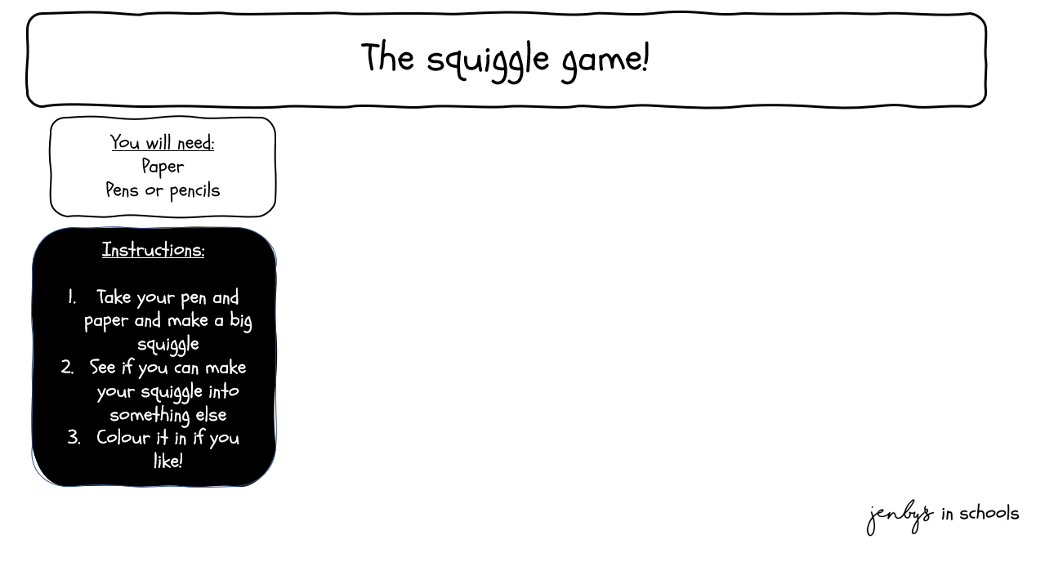


Slide 7
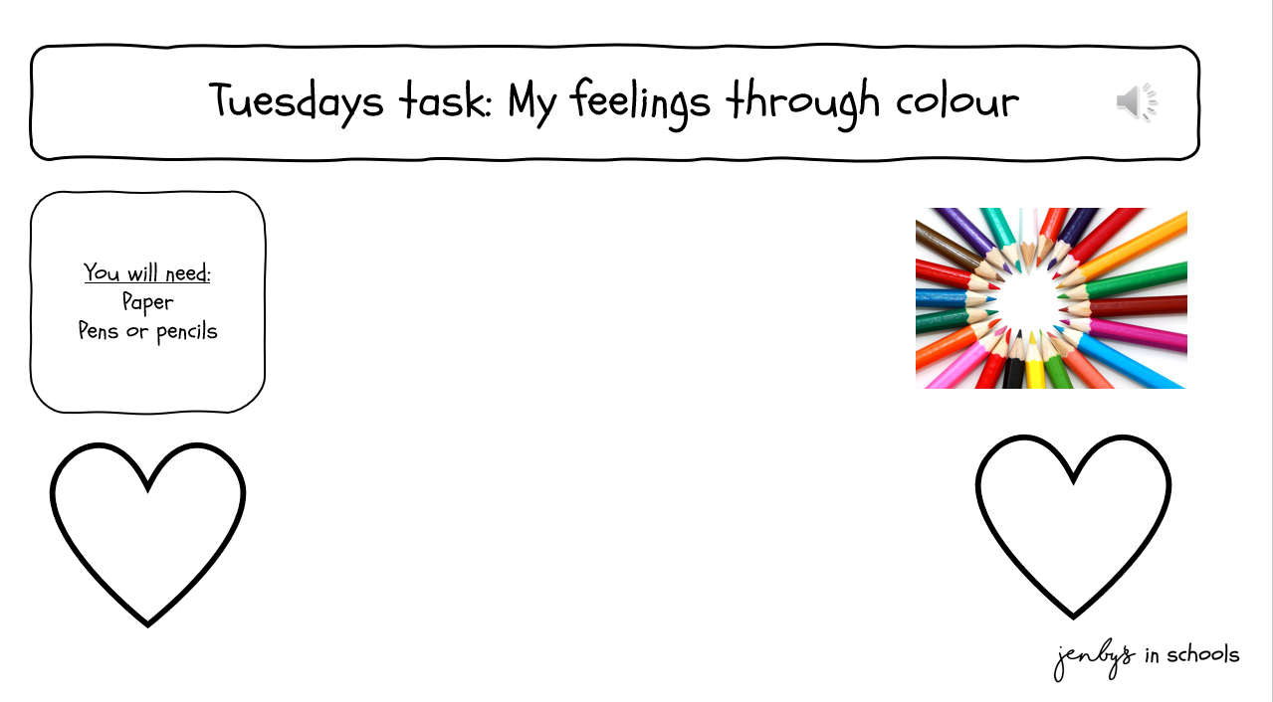
Instructions:
1. Watch: The Color Monster : Kids books read aloud by Books with Blue - YouTube
2. Draw a heart or use the “my feelings through colour” worksheet
3. List some feelings
4. Choose a colour for each feeling
5. Think about how you feel today and colour your heart in to reflect your feelings

Slide 8
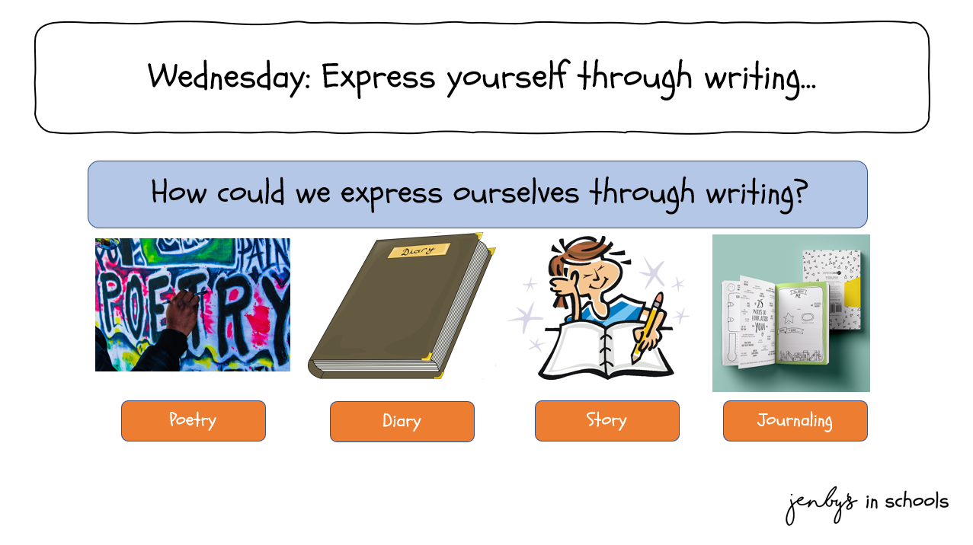
Tuesday: Expression through art

Slide 9
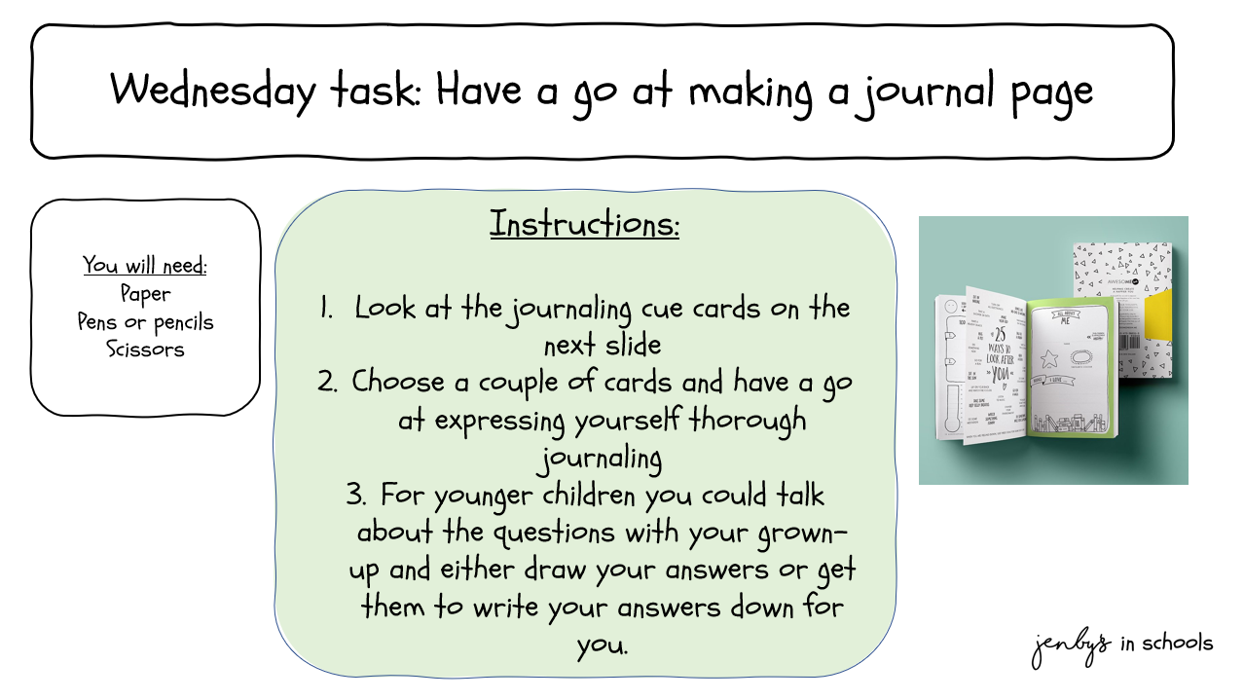

Slide 10
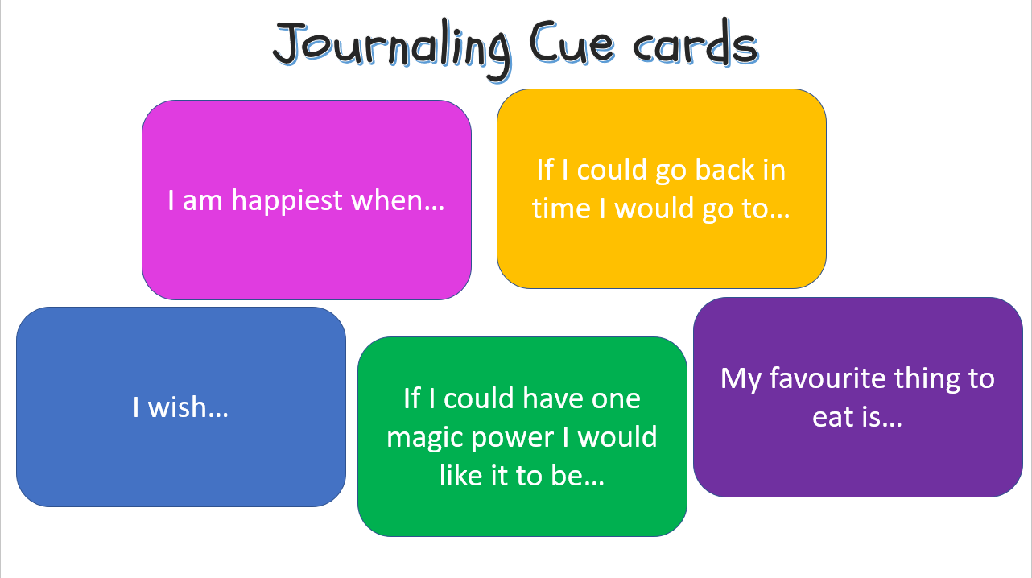

Slide 11
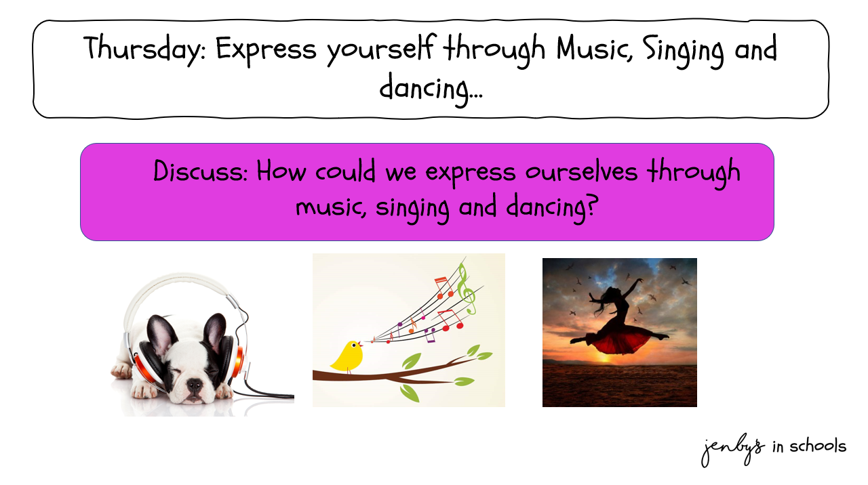
Tuesday: Expression through art

Slide 12
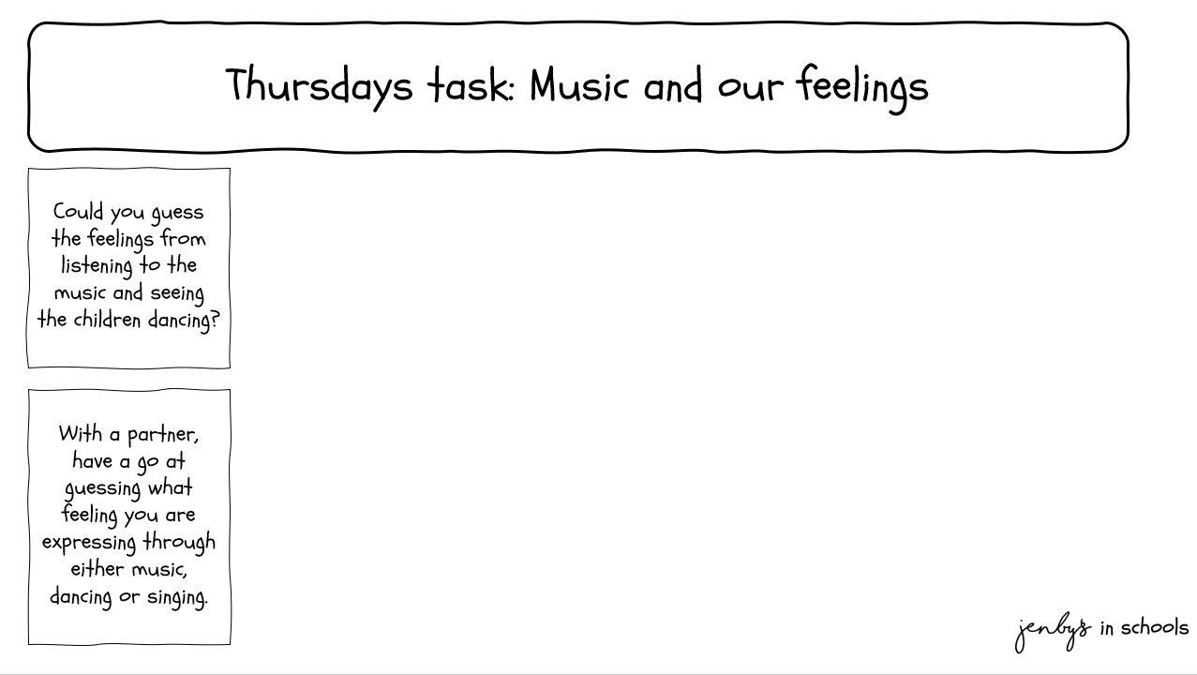


Slide 13
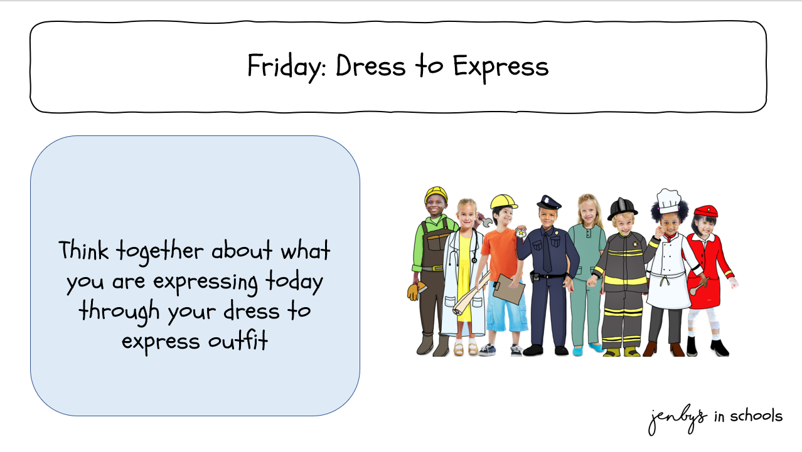
Tuesday: Expression through art

Slide 14
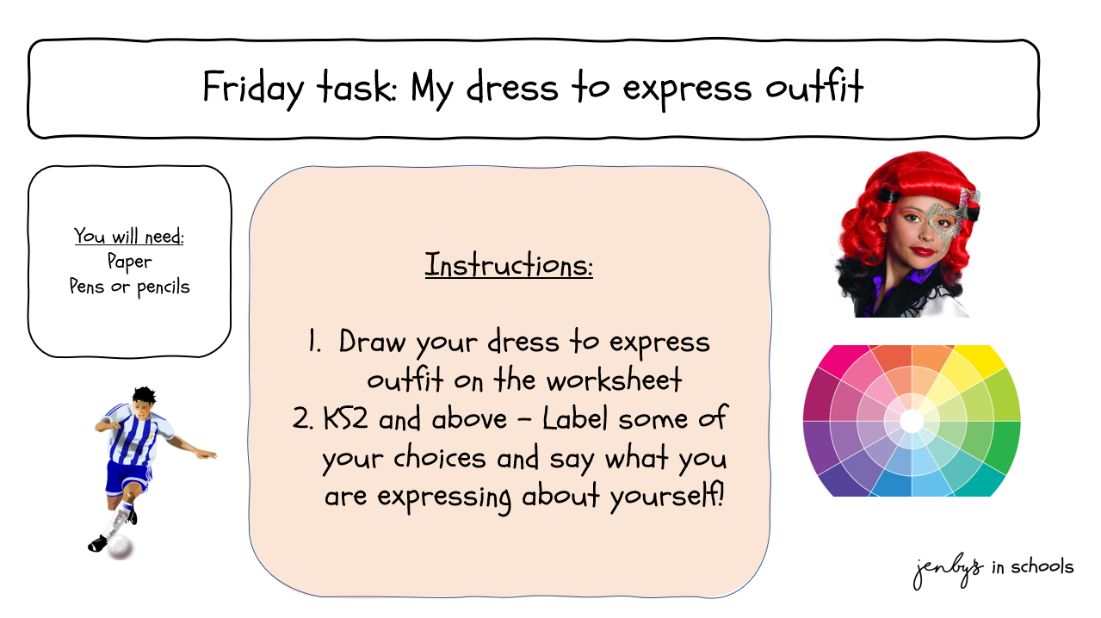

Slide 15

www.jenbys.co.uk

