Slide 1
Take 5s - in the classroom or at home
“Express yourself”
Children’s Mental Health Week: 1-5 February 2021
Monday
What does express yourself mean?
- Why is it good to find ways to express ourselves?
Tuesday
Expressing ourselves using art…
Wednesday
Expressing ourselves using writing…
Thursday
Expressing ourselves through music, singing and dance…
Friday
Expressing ourselves through our clothes and appearance…
*Dress to Express day!

Slide 2
Tuesday: Expression through art

Slide 3
Press for video: https://youtu.be/eD9xCF22jKE

Slide 4
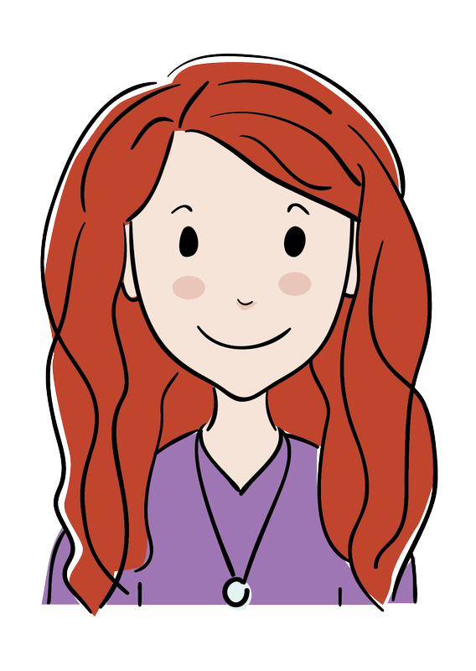
Thank you for taking part in
“Take 5s” for
Children’s Mental Health Week 2021

