Slide 1
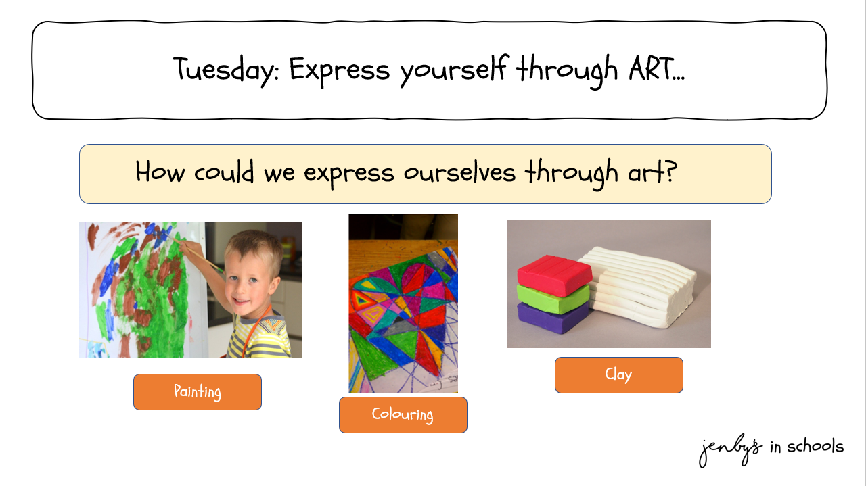

Tuesday: Expression through art
Painting
Colouring

Slide 2
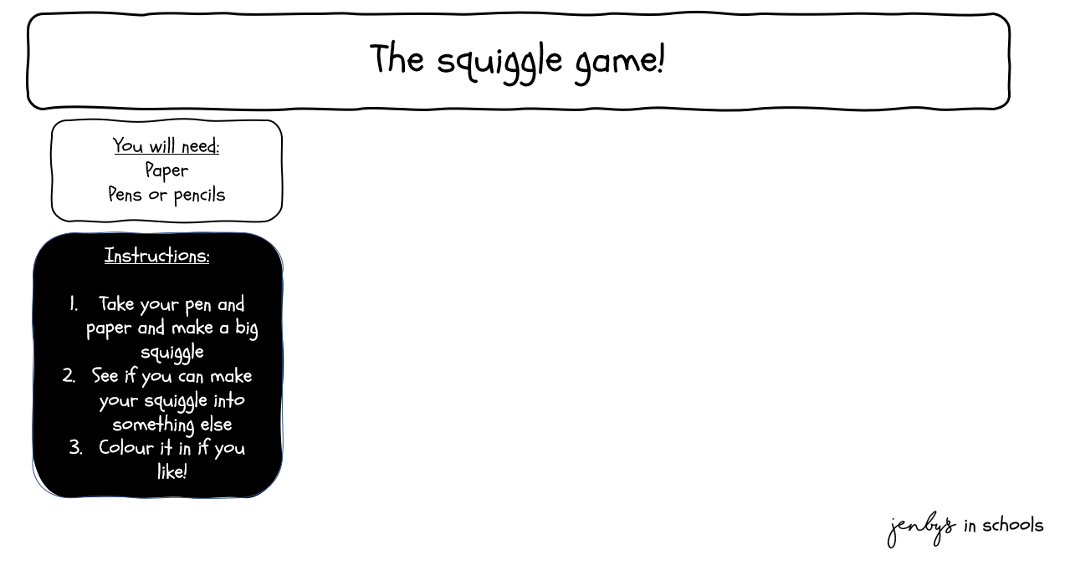


Slide 3
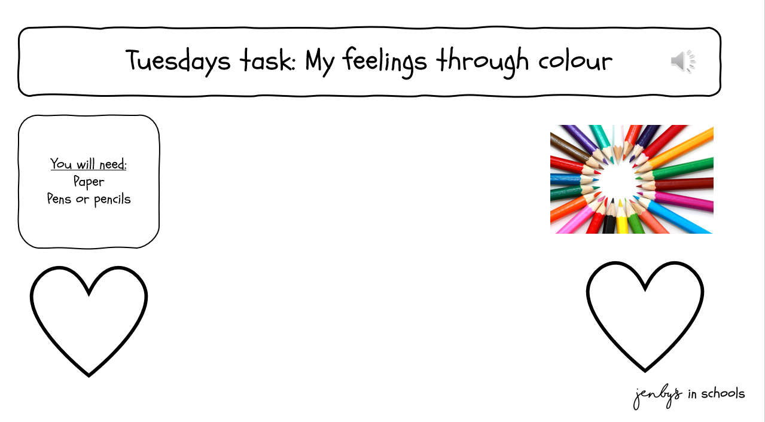
Instructions:
1. Watch: The Color Monster : Kids books read aloud by Books with Blue - YouTube
2. Draw a heart or use the “my feelings through colour” worksheet
3. List some feelings
4. Choose a colour for each feeling
5. Think about how you feel today and colour your heart in to reflect your feelings

