Slide 1
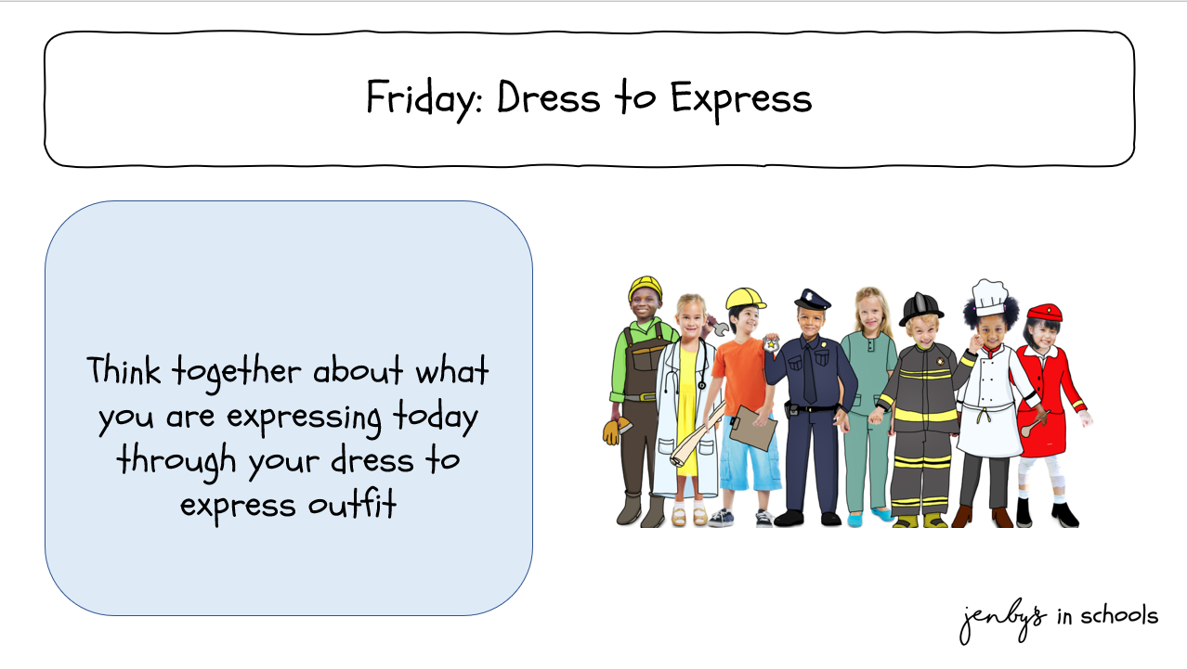

Tuesday: Expression through art

Slide 2
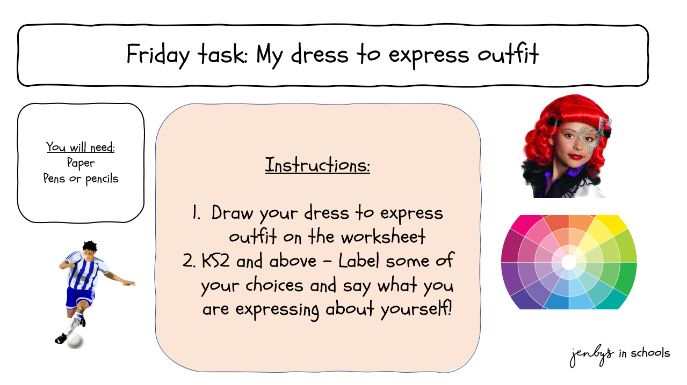

Slide 3

www.jenbys.co.uk

