Slide 1
Press link below to see the frozen video/music:
https://youtu.be/nrZxwPwmgrw

Slide 4
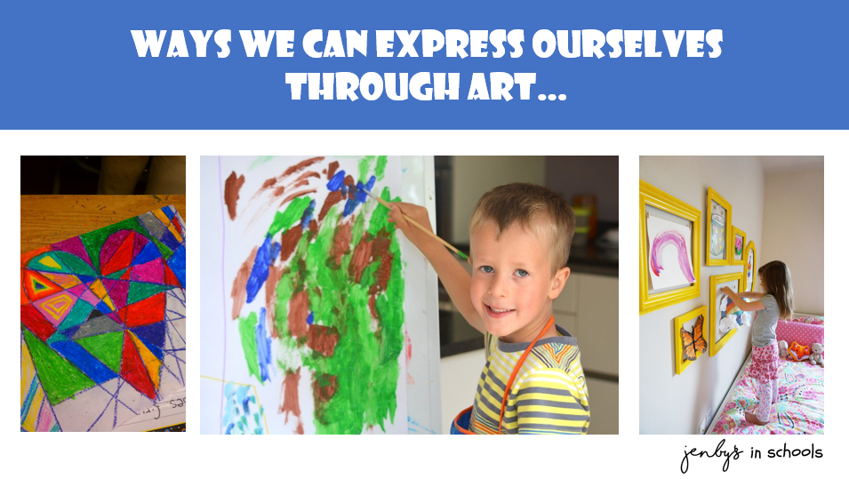

Slide 10
Share ideas
Try out new ways together
Support each other

Slide 11
Perfectly norman

Slide 16
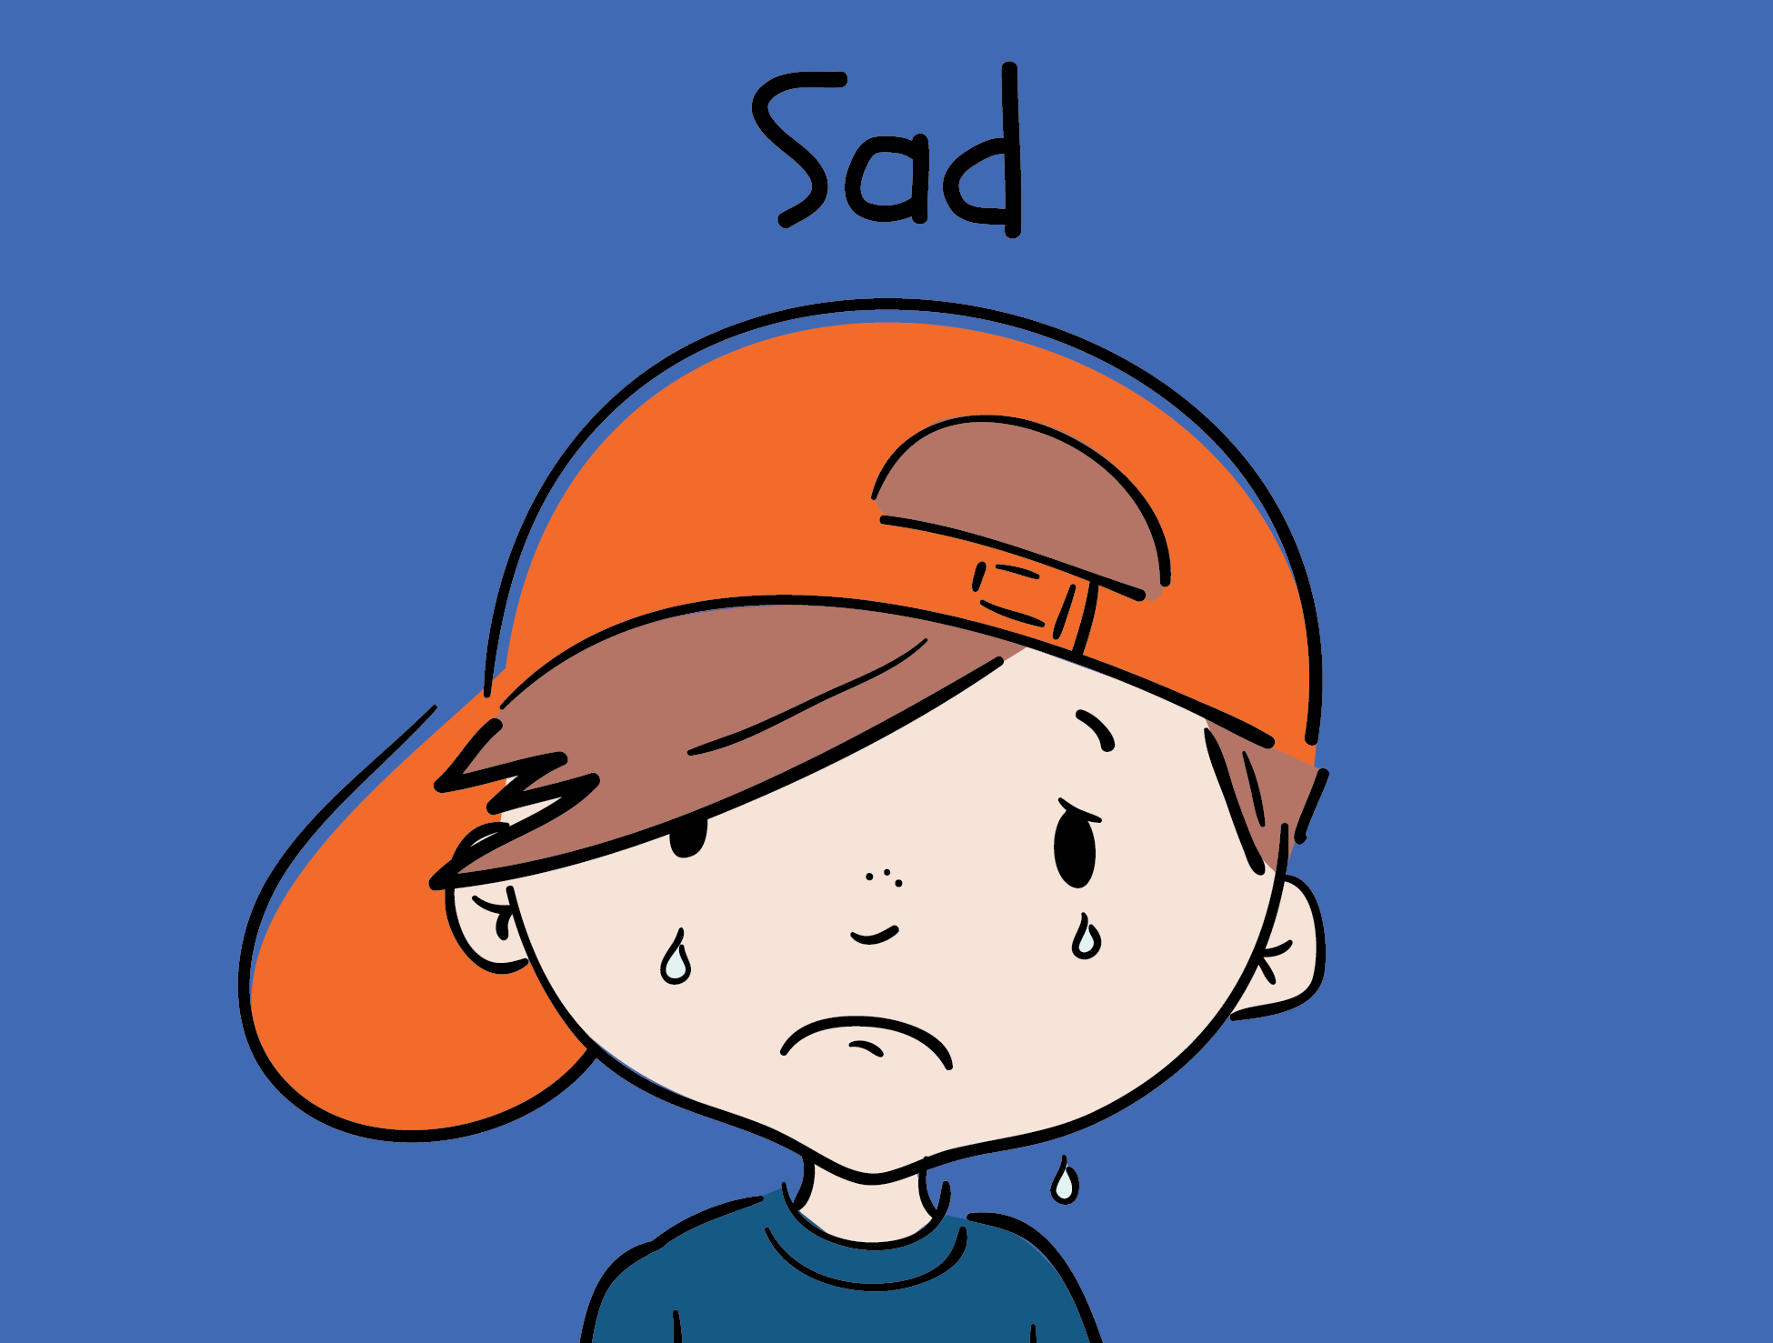
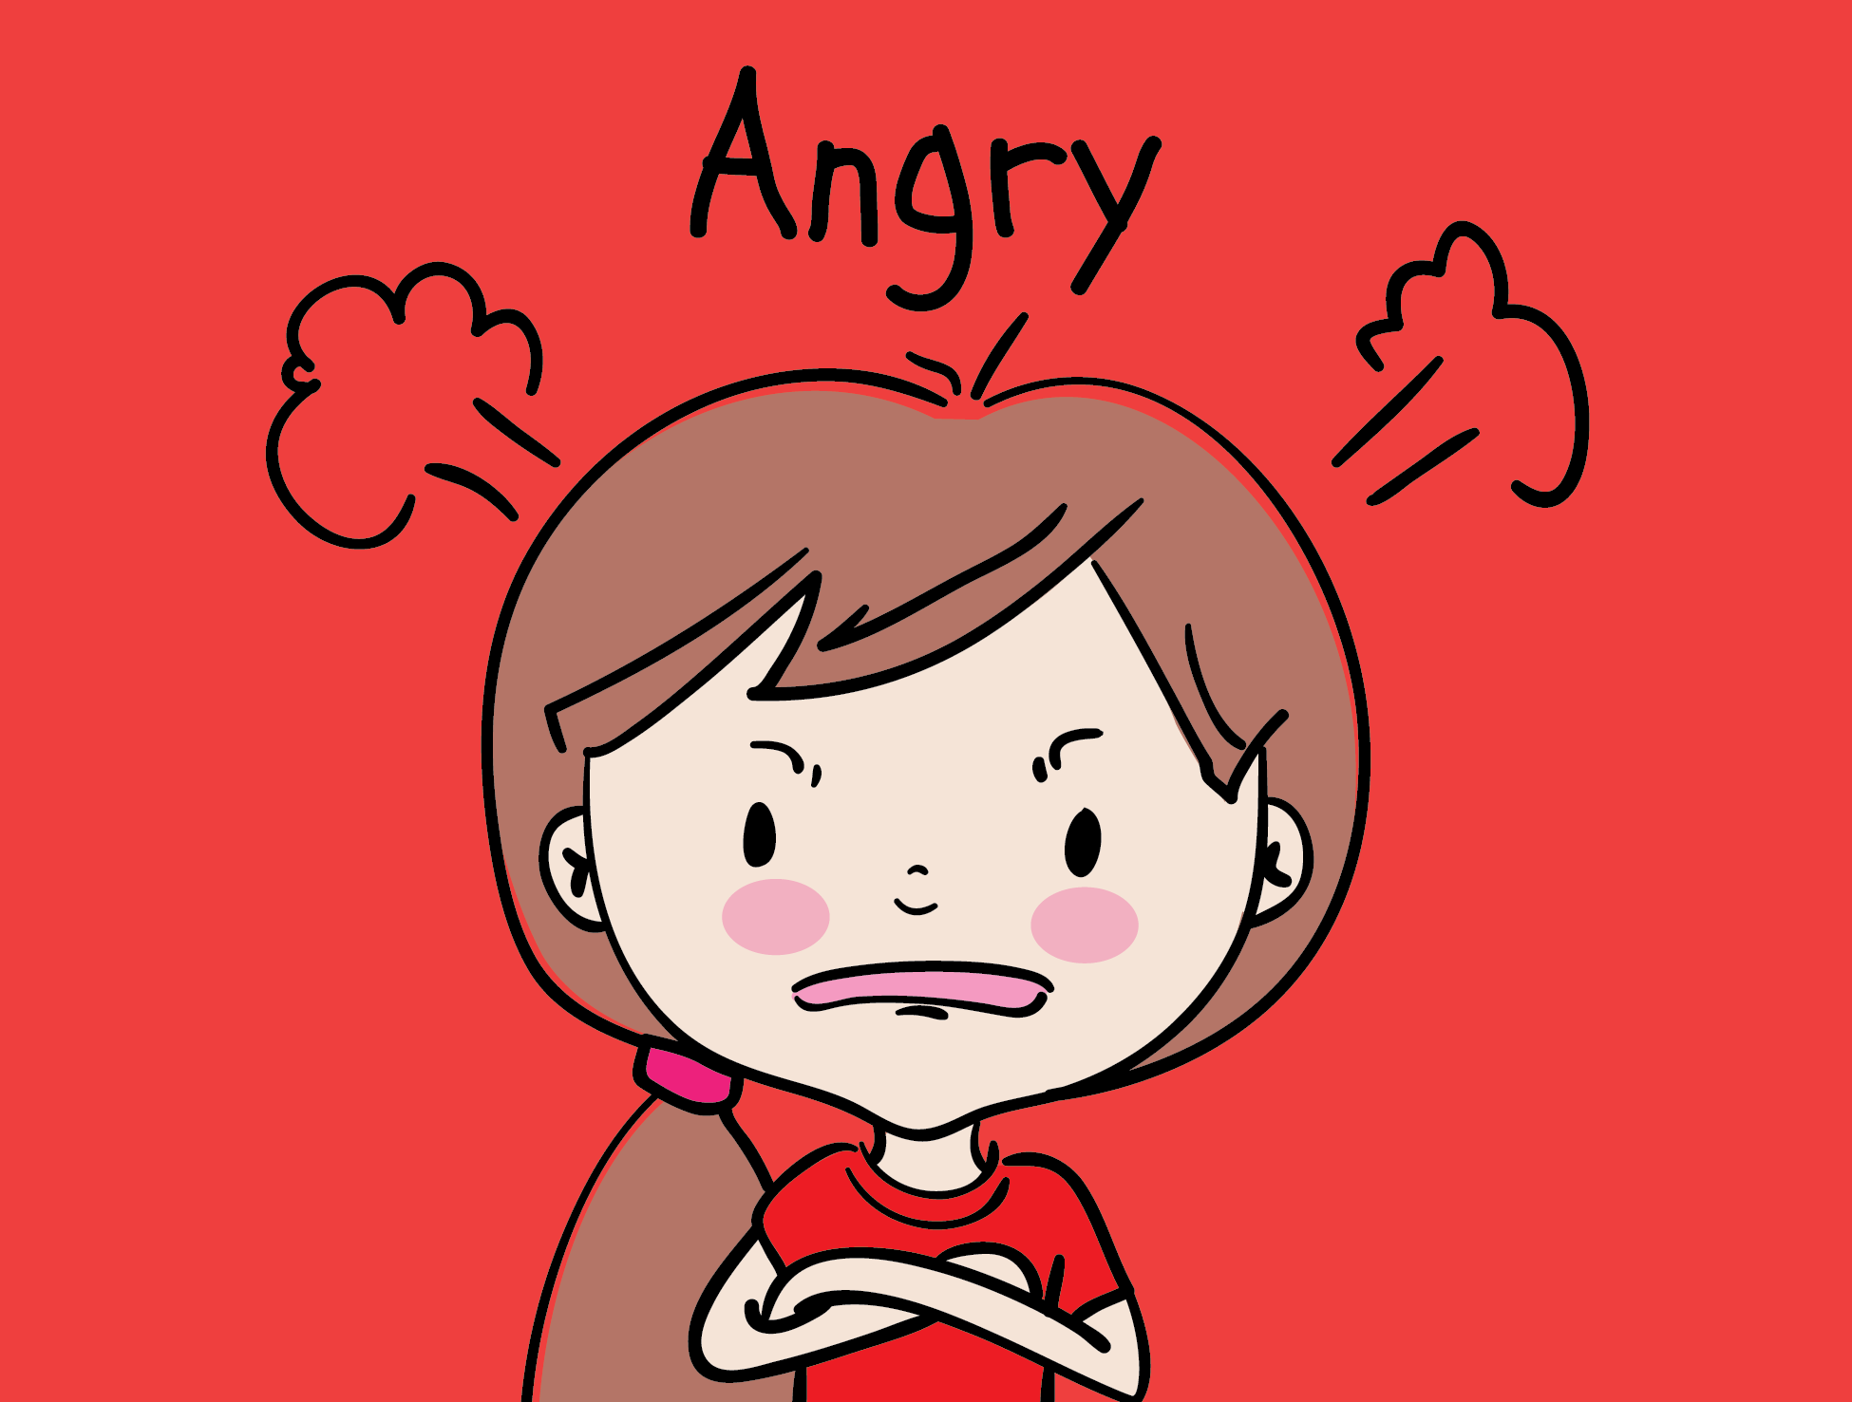
How did he feel when he covered up his wonderful wings?

Slide 17
How did he feel when he covered up his wonderful wings?

Slide 21
Why is it important to find ways to express ourselves?
It can help us understand our thoughts and feelings better
We can become better equipped to deal with big thoughts and feelings
Makes us feel better about ourselves – more confident in who we are
Improves our emotional and mental health

Slide 22
How does it fel when we think creatively to express ourselves?

Slide 23
How does it fel when we think creatively to express ourselves?

