Slide 1


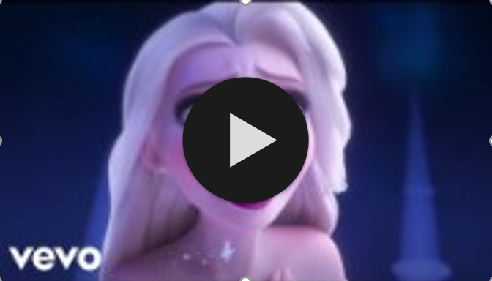
Video / music
on next slide

Slide 2
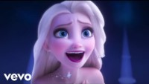

Slide 3
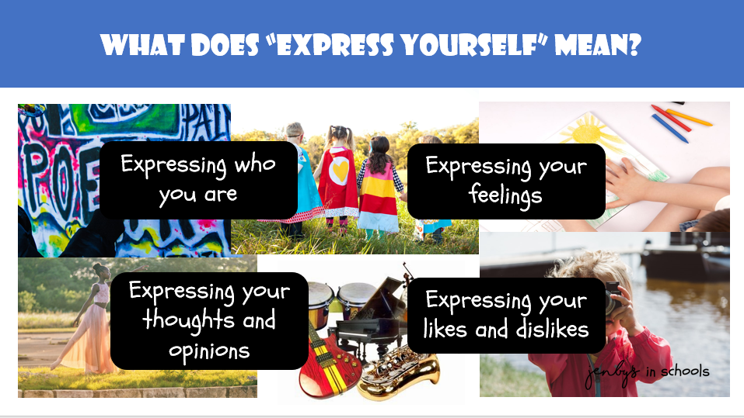

Slide 4



Slide 5
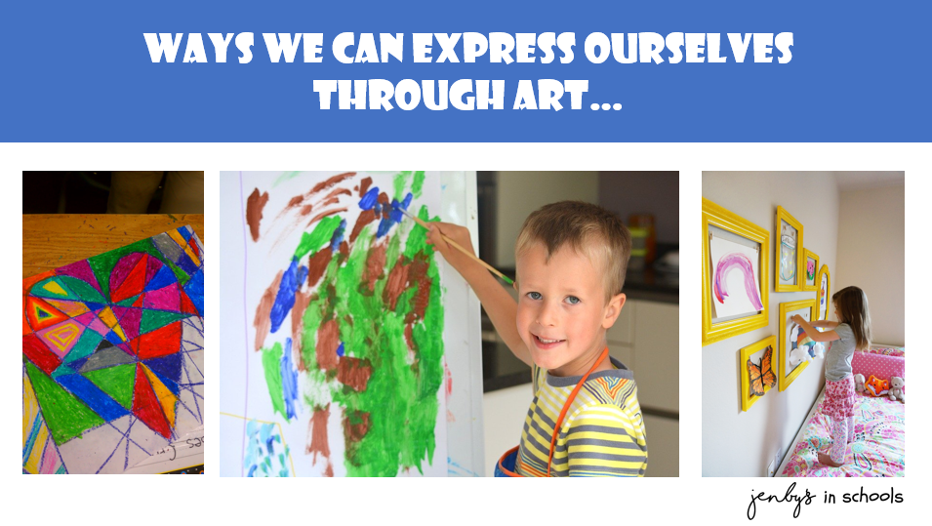

Slide 6


Slide 7
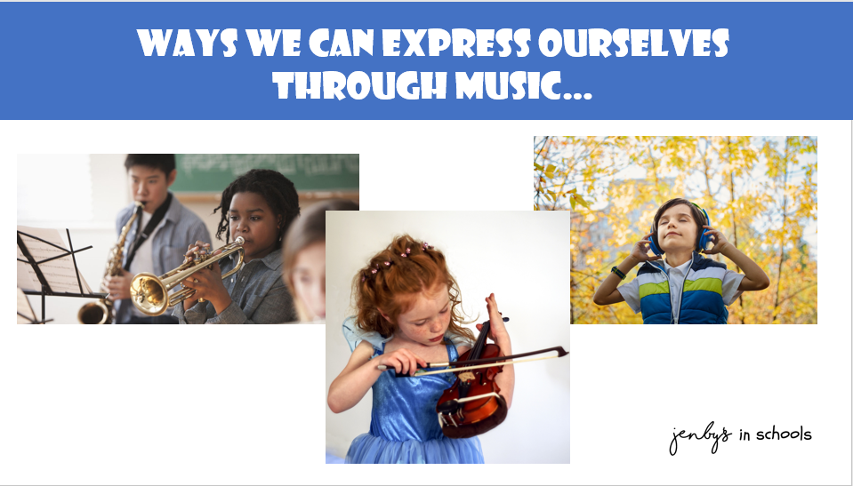

Slide 8
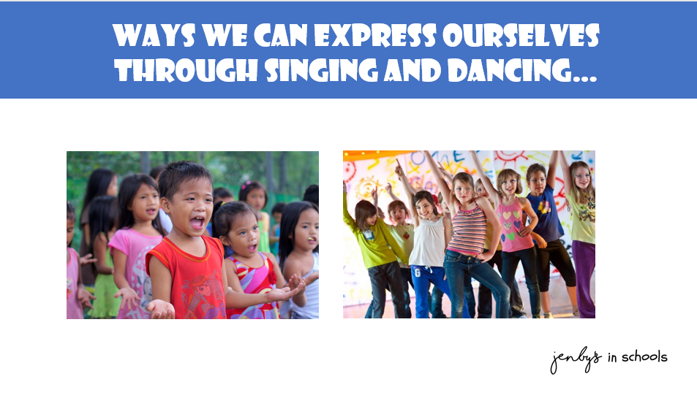

Slide 9
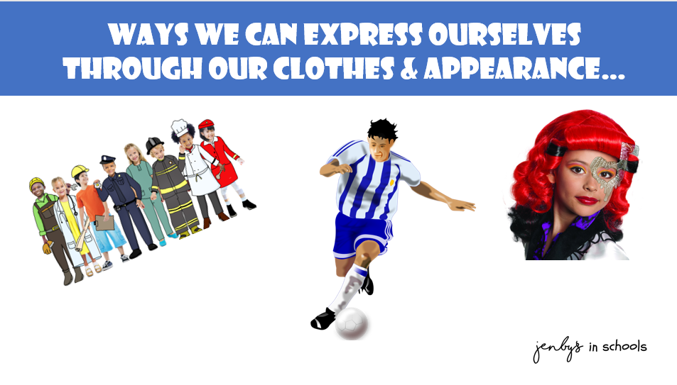

Slide 10


Slide 11

Share ideas
Try out new ways together
Support each other

Slide 12
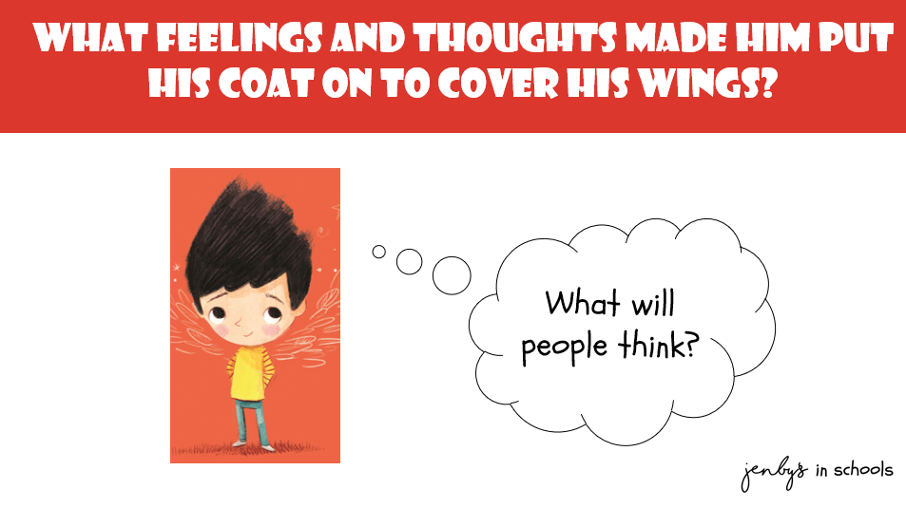
Perfectly norman

Slide 13

Perfectly norman

Slide 14
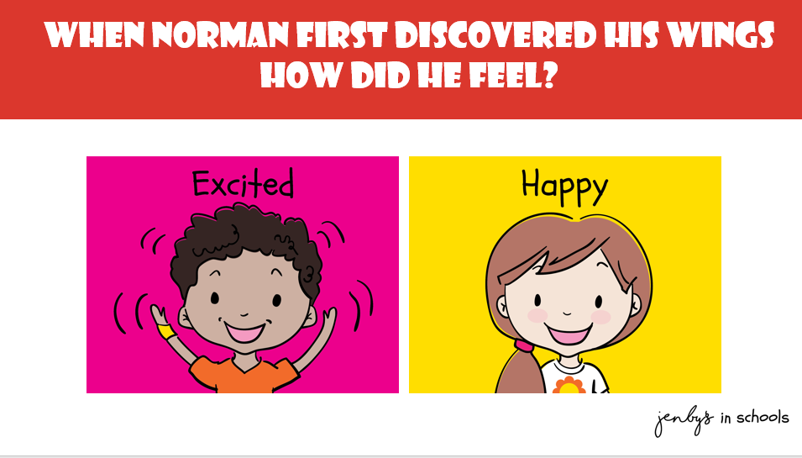

Slide 18
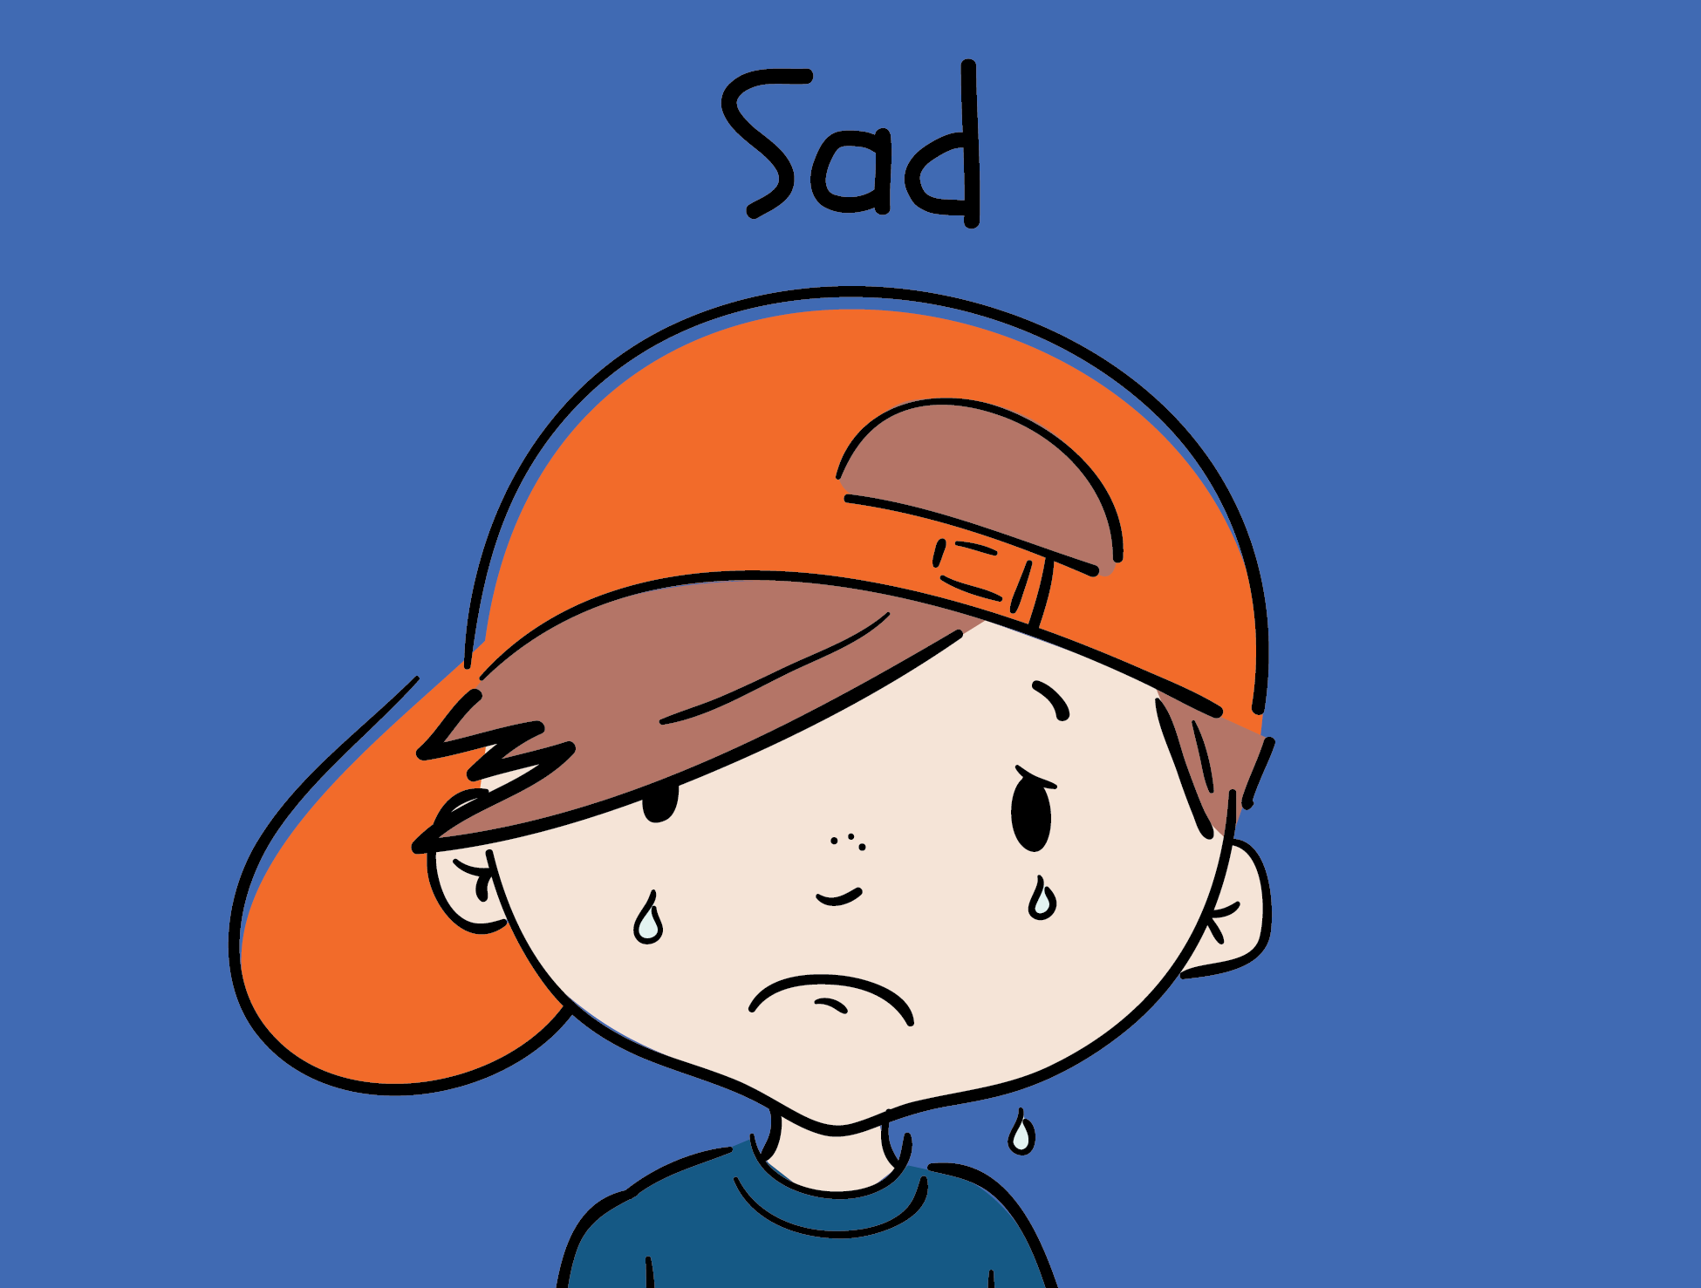
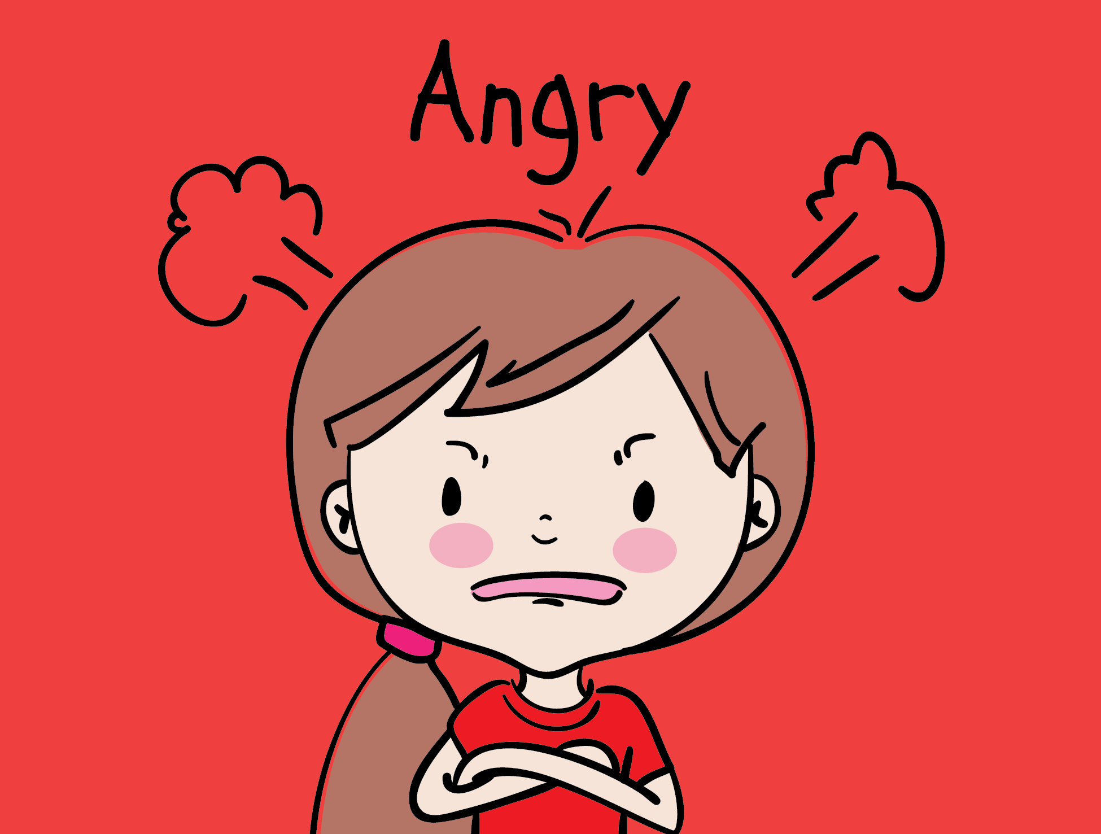

How did he feel when he covered up his wonderful wings?

Slide 19
How did he feel when he covered up his wonderful wings?

Slide 20
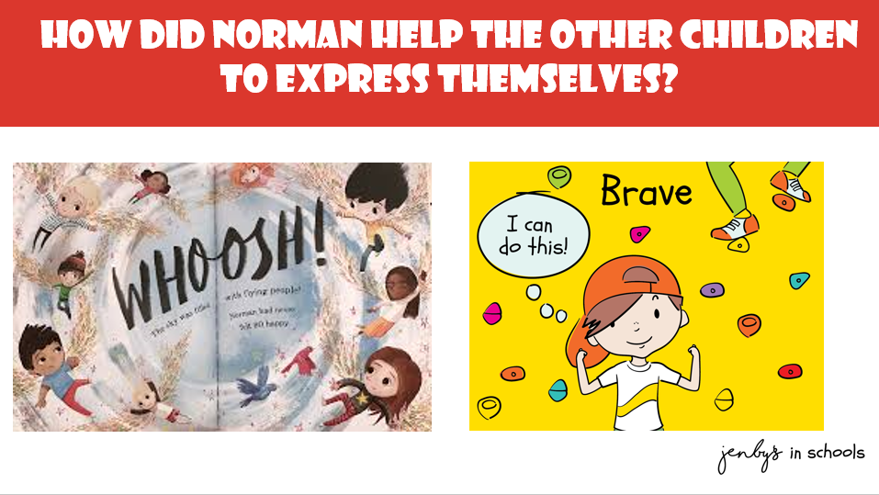

Slide 22
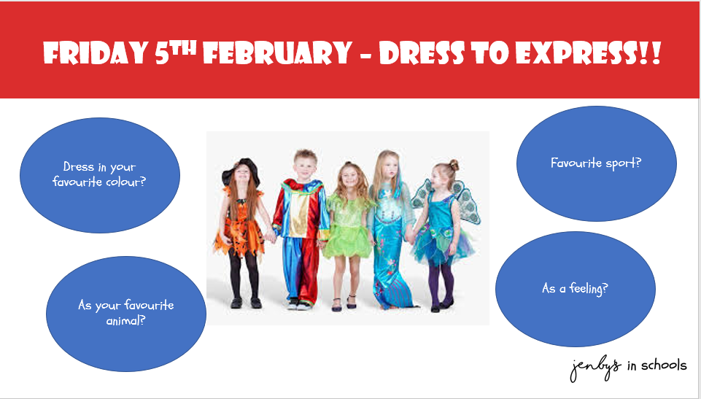

Slide 23
Why is it important to find ways to express ourselves?
It can help us understand our thoughts and feelings better
We can become better equipped to deal with big thoughts and feelings
Makes us feel better about ourselves – more confident in who we are
Improves our emotional and mental health

Slide 24
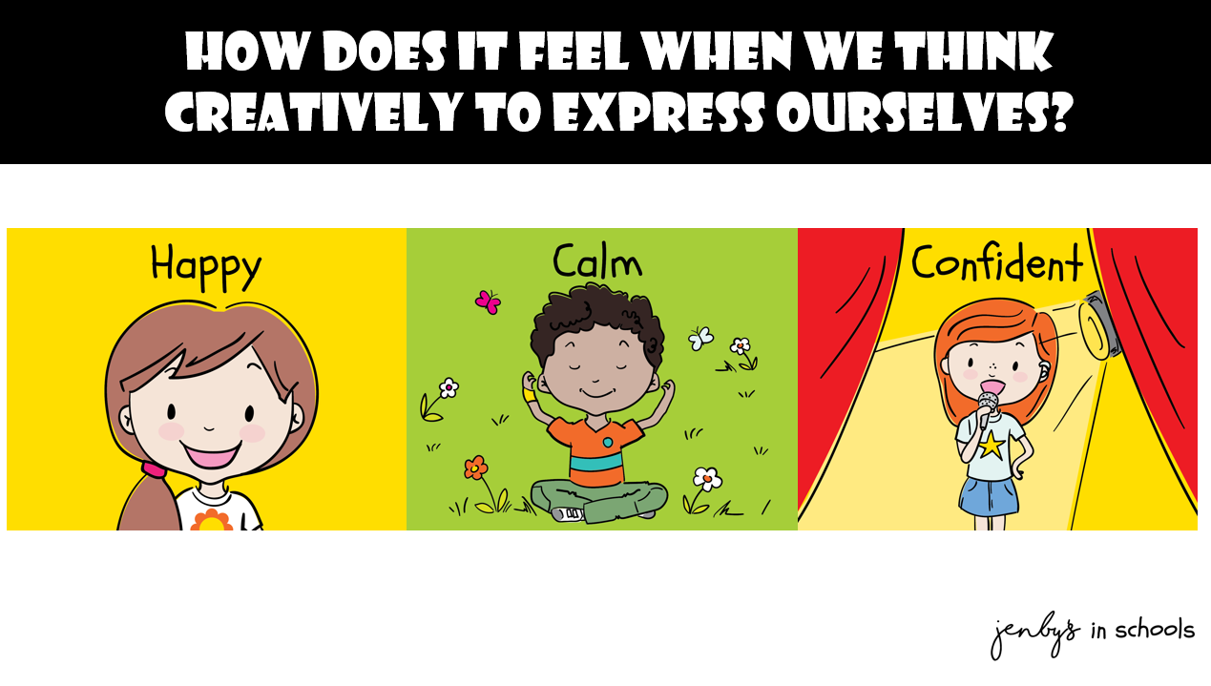
How does it fel when we think creatively to express ourselves?

Slide 25
